Slide 1
Inferential Statistics and Hypothesis Testing

Slide 2
Agenda for this session
Revision of the Topics
Q/A session
We’ll be restricting ourselves to the compulsory modules only. .

Slide 3
Major focus
Normal Distribution
Sampling Distribution and Central Limit theorem
Basic concepts of Hypothesis Testing
Critical value and P-value.
Types of Errors.

Slide 4
Basics of Probability
Random Variable (X) : A variable that converts the outcome of an experiment to something measurable.
Probability Distribution: A probability distribution for X, basically, is ANY form of representation that tells us the probability for all possible values of X.
Expected Value: The expected value for a variable X is the value of X we would “expect” to get after performing the experiment once. It is also called the expectation, average, and mean value.EV(X) = x1*P(X = x1) + x2*P(X = x2) + x3*P(X = x3) + …………………. + xn*P(X = xn)

Slide 5
Discrete Probability Distribution
Difference between theoretical and experimental probabilities
Binomial Distribution
The number of trials are fixed
There are only 2 possible outcomes for each trial.
The probability of success remains the same throughout the experiment.
If p denotes the probability of success and r is the number of successes, then we have
P(X = r) = ^{n}C_{r} p^{r}(1-p)^{n-r}

Slide 6
Cumulative Probability: Cumulative probability of x, generally denoted by F(x), is the probability of the random variable X, taking a value lesser than x. Mathematically speaking, we’d say –
F(x) = P(X <= x)

Slide 7


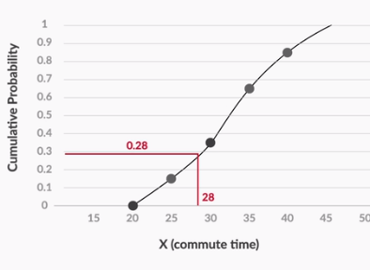

Continuous Probability
Uses intervals instead of points and hence cumulative probability is used.
Probability Density curve(PDF): Naïve defn :Rate of change of probability per unit random variable. The area under the curve gives the cumulative probability.

Slide 8
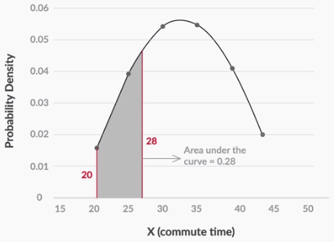
Probability density curve

Slide 9
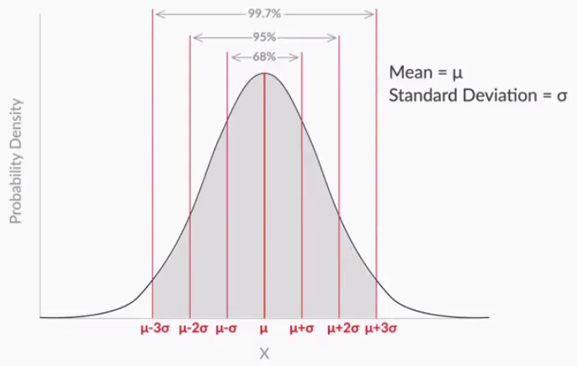
Normal Distribution

Slide 10
Standardised normal variables
In order to find the probability for a normal variable, you actually do not need to know the value of the mean or the standard deviation — it is enough to know the number of standard deviations away from the mean your random variable is. That is given by: Z = (𝑋−𝜇)/ 𝜎 This is called the Z score, or the standard normal variable.
The final value is given by z and from the table, you get the probability P(Z<=z).

Slide 11
Sampling
One of the major topics that is actually at the cornerstone of what inferential statistics is all about.
Basically, you pick a sample and infer from it the behaviour of the population.
Sampling techniques are a whole different branch altogether.

Slide 12
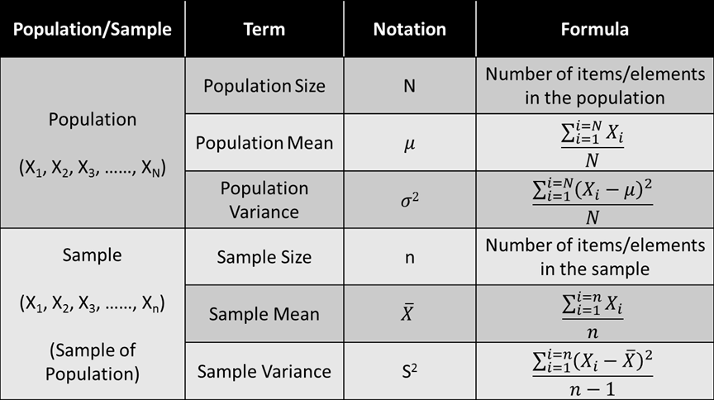
Sample/Population Calculations

Slide 13
Sampling Distribution
The idea of sampling plays a crucial role in something called sampling distribution.
Basically, given a population and a sample of size n, if you plot the distribution of the means of all the possible samples of size n, you get the sampling distribution for that particular sample size.
Short quiz: If you have a population of size 100, how many samples of size 40 can you have?

Slide 14
Sampling Distribution
The answer to the previous question is ¹⁰⁰C₄₀
Now if you create a plot of the sample means of all those ¹⁰⁰C₄₀ samples then the resultant distribution is called the sampling distribution of that size.
But why are we doing this?
Well, because of some interesting properties of the Sampling Distribution, also known as the Central Limit Theorem.

Slide 15
Central Limit Theorem: The assumptions
The mean of the sampling distribution μ_{X} is equal to the population mean μ. So if we take the mean of all those sample ¹⁰⁰C₄₀ means, then the resultant mean would be the population mean.
Sampling distribution’s standard deviation (Standard error) = σ/√n where σ and n is the sample size( which is 40 in this case).
If the sample size n>30, then no matter how crazy the original data distribution of the population is, the sampling distribution can be approximated to a normal distribution.

Slide 16
Ok, but how does it help us?
Now we can infer from the sample mean as to what would be the population mean might be.
The population mean can be estimated to a certain level of confidence which is also as confidence level(y).
The corresponding range for which the values have been computed is also known as the confidence interval.
The confidence interval is calculated as being the sample mean ± margin of error

Slide 17
Formulae
Confidence Interval = (𝑋− 𝑍∗𝑆 /√𝑛 , 𝑋+ 𝑍∗𝑆/ √𝑛 ).
From the given confidence level y % you compute the Z*.
Then you calculate the sampling distribution’s standard deviation from either the sample’s standard deviation or the population’s standard deviation.
Then you use the aforementioned formula to compute the interval.

Slide 18
Clarification regarding Z* and Z score
There is a generally confusion regarding what is Z* and how it is different or similar to Z score.
The difference lies in the way that they’re defined. For example, for 95.4% both Z* and Z score are calculated differently. [The same value is used in the example video]
Z score would ask you to find z such that P(Z<=z)=0.954.
But Z* would ask you to find the value of Z* such that P(-Z*<X<Z*)=0.954

Slide 19
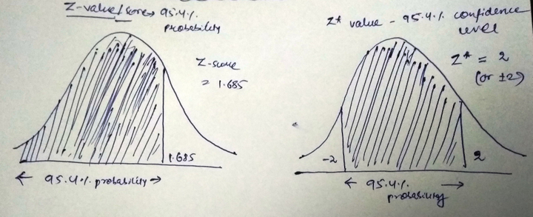
Z* => P[-Z*<X<Z*] whereas Z-score=>P[Z<=z]

Slide 20
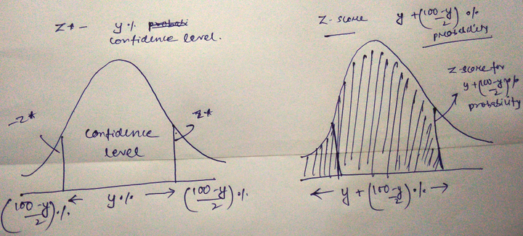
Z* contd…

Slide 21
Calculations
So by symmetry of the normal distribution we can conclude that, finding Z* for a confidence interval y% is equivalent to finding the Z-score for the probability of (100-y)/2 + y%.
For the given example, we have y=95.4%. Hence the given probability for which we need to calculate the Z score is = 95.4% + (100-95.4)/2=95.4% + 2.3% =97.7%.
Let’s see what the value of P(Z<=z)=0.977 is.

Slide 22
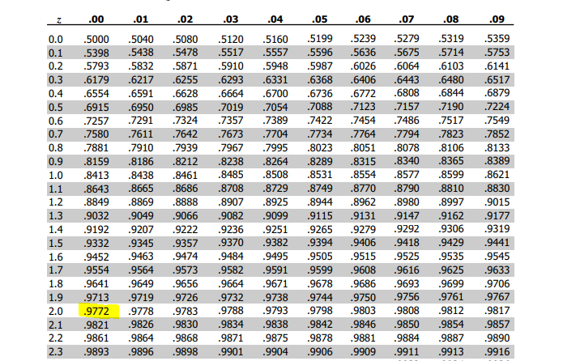

Slide 23
Hypothesis Testing
Null/ Alternate Hypothesis: Given a claim statement , the null and alternate hypothesis divide it into 2 mutually exclusive sets H₀ and H₁
Now that you’ve gone through the course at least once, here’s a short quiz.
Camlin claims that its pencils are at least 7.4 inches long on average. So in order to test this claim, you took a sample of 100 pencils and calculated its mean length and standard deviation which came out to be 7.5 inches and 2.3 inches respectively. Test the claim of Camlin’s statement at 5% significance level.

Slide 24
Solution
You can actually find the solution without even calculating anything!
The reason being the sample is already showing the behaviour as determined by the null hypothesis(H₀ >=7.4)
So without even lifting your pen you can say – “We fail to reject the null hypothesis”.
This is at the heart of hypothesis testing.

Slide 25
Fundamentals
Hypothesis testing comes into play when the sample shows a behaviour which is contrary to the null hypothesis.
Your job is to test whether the behaviour is statistically significant or not.
By statistically significant, what we mean is that you find the critical values or the p-values and test whether the result that you’re obtaining is due to random chance or because the population’s behaviour has changed.
This is the reason why we say that when we conduct a hypothesis test, we’re always out there to prove the alternate hypothesis.

Slide 26
Common Misconceptions
Misconception: We conduct hypothesis test on the sample data.
Correct answer: We always conduct the hypothesis test on the sampling distribution.
Misconception: The standard deviation that we calculate here is the sample’s standard deviation.
Correct answer: The standard deviation that we calculate here is the sampling distribution’s standard deviation.

Slide 27


Critical Value Method
From the given value of significance find Zc values depending on whether the test is 2-tailed or 1-tailed.
Then using the formula for Critical value for UCV and/or LCV we find the critical region and acceptance region.
Then we test whether the given sample mean falls in the critical region or the acceptance region.

Slide 28

P-value method
A P-value measures the strength of evidence in support of a null hypothesis.
Its technical definition is given as the probability of observing a similar or an extreme observation given the null hypothesis is true.
You calculate the Z-score of the value.
Depending on whether it is one-tailed or two-tailed you find the p-value

Slide 29
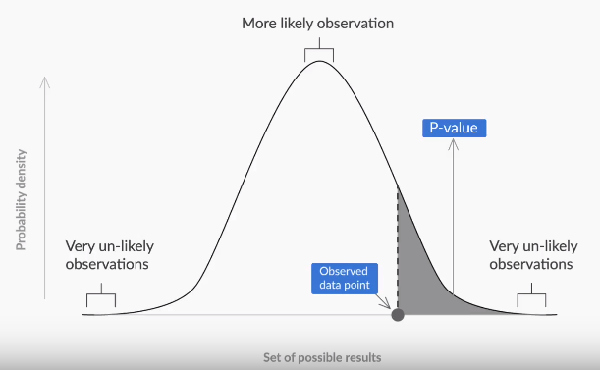

Slide 30
Types of Errors
Situation 1: Let’s say we have a population of 100 cars. Out of which we have 30 cars whose mileage is 22 kmpl, whereas the rest 70 have a mileage of 28kmpl. So the average population mileage is (70*28+30*22)/100 = 26.2 kmpl.
Now let’s say you want to test the claim that the average population mileage at least 25kmpl. For this experiment, you chose those 30 cars and hence the sample mean came out to be 22kmpl. And you rejected the null hypothesis(Assume that the standard deviation and the LOS was chosen appropriately).
Here you’ve committed a Type-1 error.

Slide 31
Types of Errors
Situation 1: Let’s say we have a population of 100 cars. Out of which we have 30 cars whose mileage is 22 kmpl, whereas the rest 70 have a mileage of 28kmpl. So the average population mileage is (70*28+30*22)/100 = 26.2 kmpl.
Now let’s say you want to test the claim that the average population mileage is at least 27kmpl. For this experiment, you chose those 70 cars and hence the sample mean came out to be 28kmpl. And you failed to reject the null hypothesis(Assume that the standard deviation and the LOS was chosen appropriately).
Here you’ve committed a Type-2 error.

Slide 32
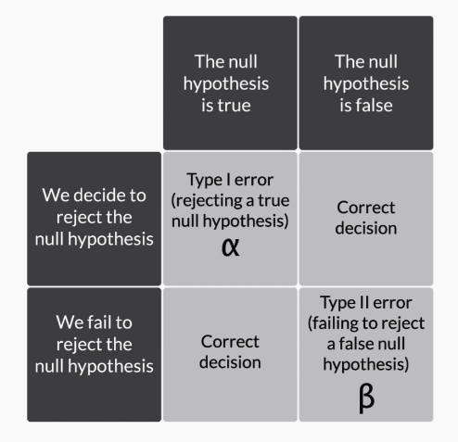
Types of Errors
Since we’re trying to prove the alternate hypothesis in a hypothesis test, the Type-1 error is also known as a false positive and Type-2 error is known as a false negative.

Slide 33
Trade-Offs in alpha and beta
Imagine a teacher wants to guess how many of its students will score 100 in the next Maths paper. She is taking the previous test as the criteria for deciding how to choose them
She decided to keep a cut-off of 90 marks as the criteria, and found out 7 students who clear the cut-off with marks – 99,97,96,93,92,91,91.
Next she decided to increase the cut-off to 95. For this, the students that were selected were 3- 99,97,96.

Slide 34
Trade-offs continued
By increasing the cut-off, we reduced the number of students who fall into the category.
But also, we made sure that the students who are selected have a better chance of scoring 100.
Similarly, alpha and beta are also related.

Slide 35
Trade-Offs contd..
When you increase alpha, the probability of falsely rejecting the null hypothesis increases, but when we do fail to reject the null hypothesis, we have a stronger evidence now that our decision was correct. So 1-beta increases or beta decreases( the probability of accepting a false null hypothesis)
Similarly, when you decrease alpha, the probability of falsely rejecting the null hypothesis decreases, but it also makes it easier to accept a false null hypothesis and hence the value of beta increases.

Slide 36
Example
Let’s say you have a H0 which states that u <=70 and the sample mean was 75.
At alpha = 0.05, you have the UCV as 75.4.
At alpha =0.10, you have the UCV as 74.3
(Please note that these are hypothetical values. The only pattern that remains same here is that the UCV would decrease given that the alpha value is increasing)
In the second case, it is much easier to reject the null hypothesis. But it also made it harder for us to make a mistake if in fact we are failing to reject it.

Slide 37
Trade-offs
Alpha value needs to be considered when the producer is at a higher risk. So if the consumer doesn’t face a huge risk if the product is faulty and gets passed, then we need to make sure that the alpha value is low , even though beta value is high.
Beta value needs to be considered when the consumer is at a risk. We need to keep it low, so that we aren’t falsely failing to reject a null hypothesis

